Slide 1
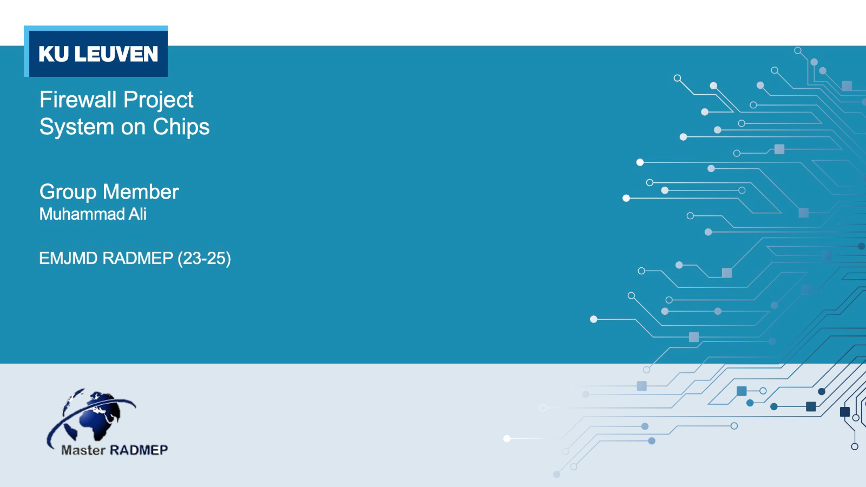
GitHub repository: https://github.com/muali98/TCP-firewall

Slide 2

Firewall
Numbers
1233…
Numbers
Symbols
(@){$}
Alphabets
Alphabets
ABC abc ..
Firewall

Slide 3
Flow diagram
Payload length
BRAM
TCP packet
Microblaze
Packet sender
Zynq
Mailbox
DDR
Payload

Slide 4
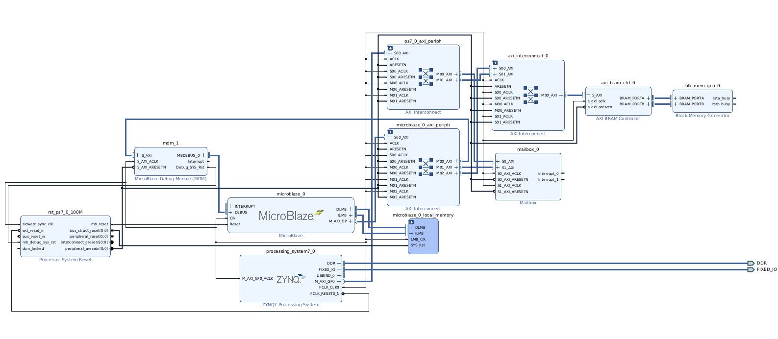
Hardware Design

Slide 5
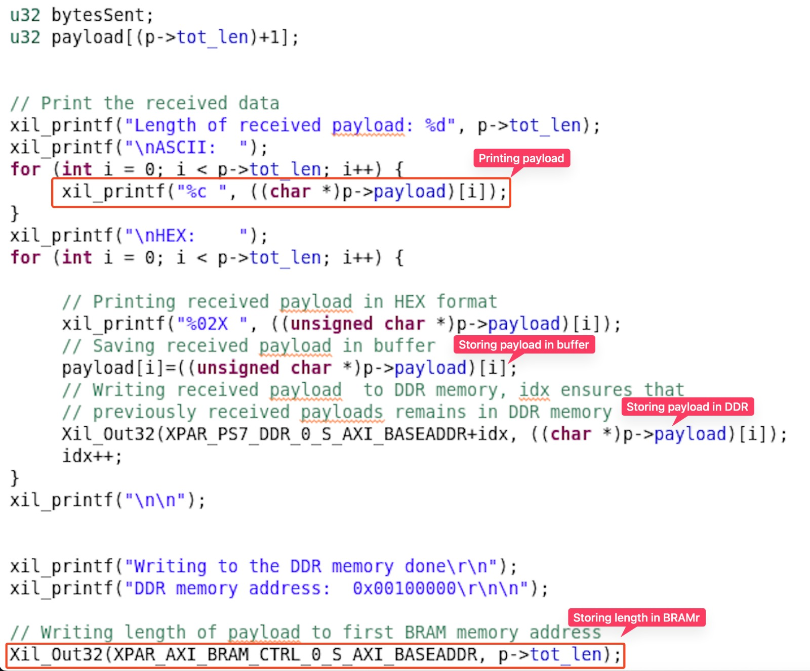
Receiving and storing payload

Slide 6
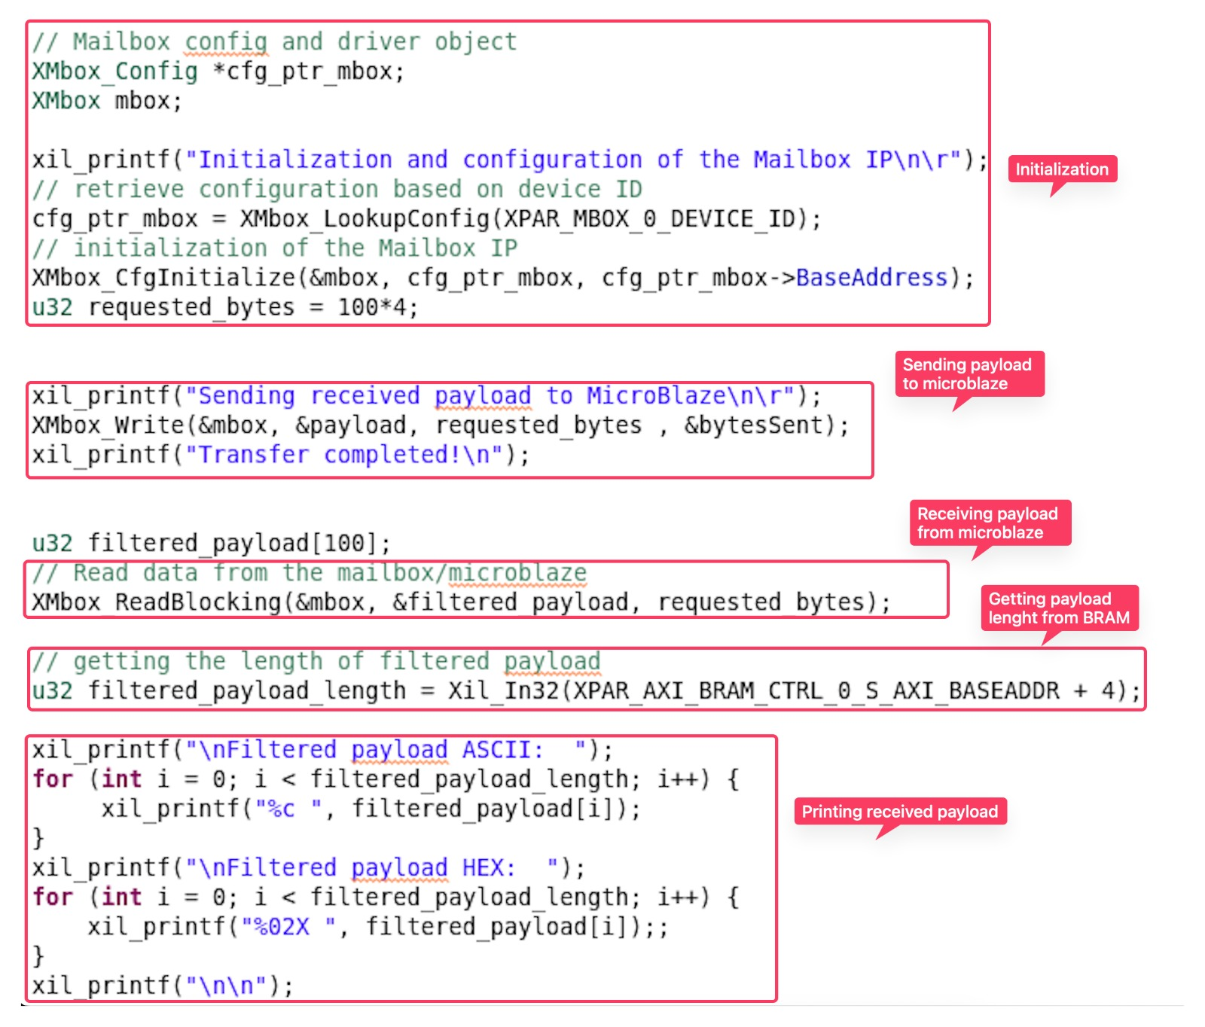
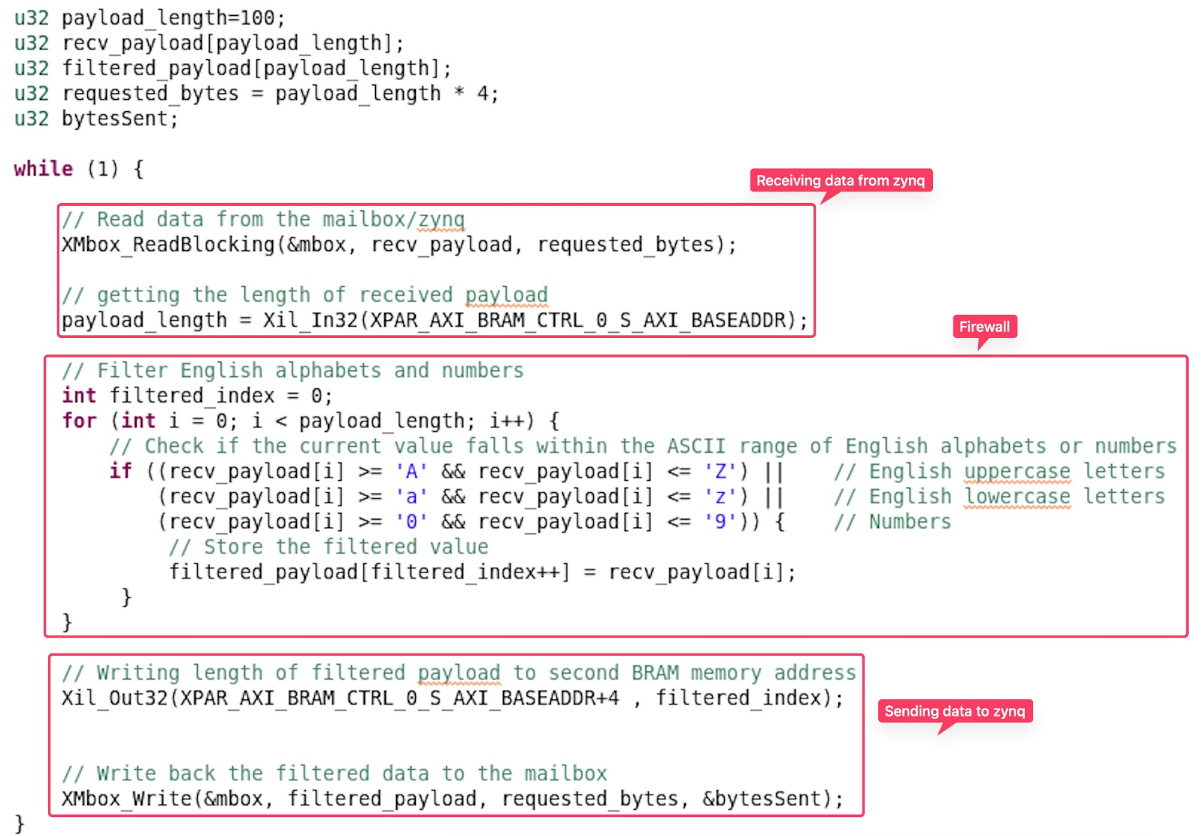
Mailbox on Zynq
Microblaze

Slide 7
Thank You

